Slide 1
On-Premise to Cloud Migration
Team Cloud: Andrew Bae, Jonathan Nguyen, Osman Choudhary, Yobell Woldu, & Nandu Rami

Slide 2
Requirements Definition
Functional Requirement | Descriptions | Examples
Process-Oriented | A process the system must perform; a process the system must do | Provide document versioning Checking in and out documents Provide an accessible place for departments to come together to work cooperatively Provide real-time access for employees where ever they are logged in and have access to

Slide 3
Requirements Definition
Information-Oriented | Information the system must contain | Real-time document editing DB retains all department information for 10 years Past version history and recall previous versions if need be Archives and reduces overall data size of documents automatically if unused for a long time Active Directory-esque role based assignments for department web-pages

Slide 4
Requirements Definition
Nonfunctional Requirement | Description | Examples
Operational | The physical and technical environments in which the system will operate | Microsoft Sharepoint will be used as cloud database Compatible with any Web browser All existing documents should be transferred over to the cloud
Performance | The speed, capacity, and reliability of the system | The database should be accessible 24/7 Users can access database simultaneously Offsite management of DB allows better DR plans

Slide 5
Requirements Definition
Security | Who has authorized access to the system under what circumstances | Each department will have personalized and private Sharepoint web-pages Sharepoint will offer a company wide web-page for all employees to interact with each other and offer inputs.
Cultural & Political | Cultural and political factors and legal requirements that affect the system | The company must account for the differing time zones Workplace culturally, people must become used to and consistently work toward using the checking in and checking out feature

Slide 6
Interview Process
Positions Needed:
Cloud & Infrastructure Department Head
Manage cloud infrastructure and vendors, including capacity costing, growth projections, monitoring, and feedback loops to improve cloud performance
Lead & Junior Sharepoint Designer
Responsible for designing, maintaining, and enhancing applications software, websites, and web applications for organization
Junior will assist Lead Sharepoint Designer

Slide 7
Interview Process
Interviewee: John Sean
Position: Cloud and Infrastructure Department Head
Date and Time: March 12, 2018 10:00 A.M
Interviewer: Andrew Bae
Summary: Interviewee demonstrated professionalism, contained 4+ years of C&I at small start-up company, and has a strong understanding of Microsoft Sharepoint. Strong candidate for the position
Interview Questions:
Explain your time at the C&I department at your previous job and how they used Sharepoint and how those skills can be translated into our team?
Have you had experience working with C&I before? What about the migration of data from local to a cloud based system?
Having worked with Microsoft Sharepoint in the past, what were some growing pains with it, and how do you manage the growing pains this time around?

Slide 8
Interview Process
Interviewee: Kobe Bryant
Position: Cloud and Infrastructure Department Head
Date and Time: March 12, 2018 11:00 A.M
Interviewer: Andrew Bae
Summary: Interviewee demonstrated professionalism,but doesn’t have prior experience with C&I or Sharepoint (willing to learn). 5x NBA champion and recently won an oscar. Weak candidate for the position.
Interview Questions:
Have you had experience working with C&I before? What about the migration of data from local to a cloud based system?
What made you interested in C&I and how can it be beneficial for our company to hire a department head with such little experience in the field?
Do you plan on getting an experience prior to hiring in terms of certificates or classes?

Slide 9
Interview Process
Interviewee: Forrest Gump
Position: Lead Sharepoint Designer
Date and Time: March 13, 2018 10:00 A.M
Interviewer: Jonathan Nguyen
Summary: Interviewee has created a few pages/domains before and has faced little challenges doing so. Doesn’t believe technology is shifting into the field of cloud...therefore is a weak to moderate candidate for the position.
Interview Questions:
How many Sharepoint pages and domains have you created so far?
What are some hardships that you faced whilst creating those pages and domains and how have you overcome them?
What do you feel is the most important part of cloud and infrastructure?
Do you feel that technology is shifting into the field of cloud? Why?

Slide 10
Interview Process
Interviewee: Jane Doe
Position: Lead Sharepoint Designer
Date and Time: March 13, 2018 11:00 A.M
Interviewer: Jonathan Nguyen
Summary: Interviewee is at average level of comprehension with technological aspects relating to Sharepoint. Basic hands-on skills and may be challenging to train. Therefore, awarding her with the position is skeptical.
Interview Questions:
How many years of experience do you have with Sharepoint and what year are you most comfortable with?
Do you have any prior design experience? If so, please explain some of your work.If not, why do you believe you are fit for this position?

Slide 11
Interview Process
Interviewee: LeBron James
Position: Junior Sharepoint Designer
Date and Time: March 14th, 2018 10:00 A.M
Interviewer: Nandu Rami
Summary: Interviewee is 3x NBA champion and hopes to expand knowledge outside of basketball. However, majority of his time is dedicated to playing the sport so this will not be the first priority which is not acceptable as the position calls for full attention.
Interview Questions:
How many Sharepoint pages and domains have you created so far?
What are some hardships that you faced whilst creating those pages and domains and how have you overcome them?
What do you feel is the most important part of cloud and infrastructure?
Do you feel that technology is shifting into the field of cloud? Why?

Slide 12
Interview Process
Interviewee: Steve Jobs
Position: Junior Sharepoint Designer
Date and Time: March 14th, 2018 12:00 P.M
Interviewer: Osman Choudhary
Summary: Interviewee is well-known for his work in the technological field. Possesses outstanding knowledge with applications such as Sharepoint and can easily distinguish the most significant parts that are to be implemented in the construction phase. Very noticable amount of experience and is the most qualified for the position.
Interview Questions:
How many years of experience do you have with Sharepoint and what year are you most comfortable with?
Do you have any prior design experience? If so, please explain some of your work.If not, why do you believe you are fit for this position?

Slide 13
Observation Notes
On-premise DB:
Server room maintenance costs are very expensive
Server requires dedicated space in the office (very consuming)
Users are unable to simultaneously work on documents
Users overwriting documents due to lack of check-in, check-out function.

Slide 14
Questionnaire
Sample size: Entire employee base
Response rate: 87% response
Distribution date/ Collection date: 1/1/2018 - 3/1/2018
Questionnaire Description: Users were asked to rate their experience with our current system, listed the features of cloud based databasing and to rate to features from “Very Unimportant” to “Very Important”
Survey

Slide 15
Document Analysis
https://www.salesforce.com/uk/blog/2015/11/why-move-to-the-cloud-10-benefits-of-cloud-computing.html
https://www.wired.com/insights/2012/10/move-to-cloud-consider-saas/
http://www.onlinetech.com/resources/references/top-5-reasons-why-your-company-should-transition-to-private-cloud-computing

Slide 16
Use Case One
Use Case Name: Active Directory ID: UC-1
Actor: User
Description: The user will login to the database, which would be verified through active directory.
Trigger: User attempts to access webpage
Type: External

Slide 17
Use Case One
Preconditions:
Active Directory is up-to-date
User contains login information
Normal Course:
Sharepoint confirms with Active Directory to see if user has privilege
Sharepoint loads site for user

Slide 18
Use Case One
Exception:
Sharepoint doesn’t find User on Active Directory
Sharepoint prompts user to ask for privilege
Sharepoint stops loading
Postcondition:
Sharepoint is loaded

Slide 19
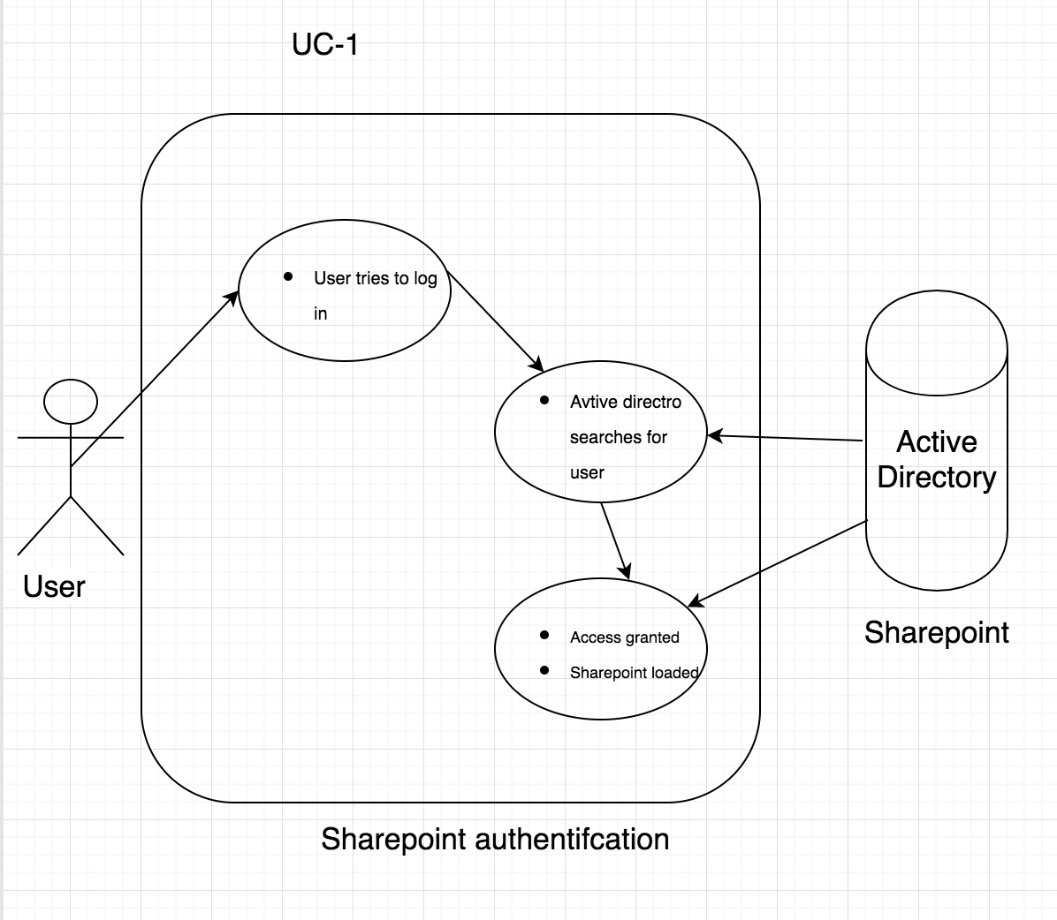
Use Case One

Slide 20
Use Case Two
Use Case Name: Check-Out ID: UC-2
Actor: User
Description: User will request to check-out a document to edit.
Trigger: User attempts to access a document
Type: External

Slide 21
Use Case Two
Preconditions:
User has privilege to load sharepoint site
Document exists
User has privilege to check-in/check-out document
Normal Course:
Document is able to be checked out
User is given prompt to either check-out document or download as read-only

Slide 22
Use Case Two
Exception Course:
1.0 - Document is checked out
Document is checked out already
User is prompted to either contact person who checked it out or open a read-only copy
2.0 - User does not have access to check in or out
User prompted about privilege status, offered read-only case

Slide 23
Use Case Two
Post conditions:
User either checks out the document, or takes a read-only version of the document.
User can check in the document afterwards IF checked out earlier.

Slide 24
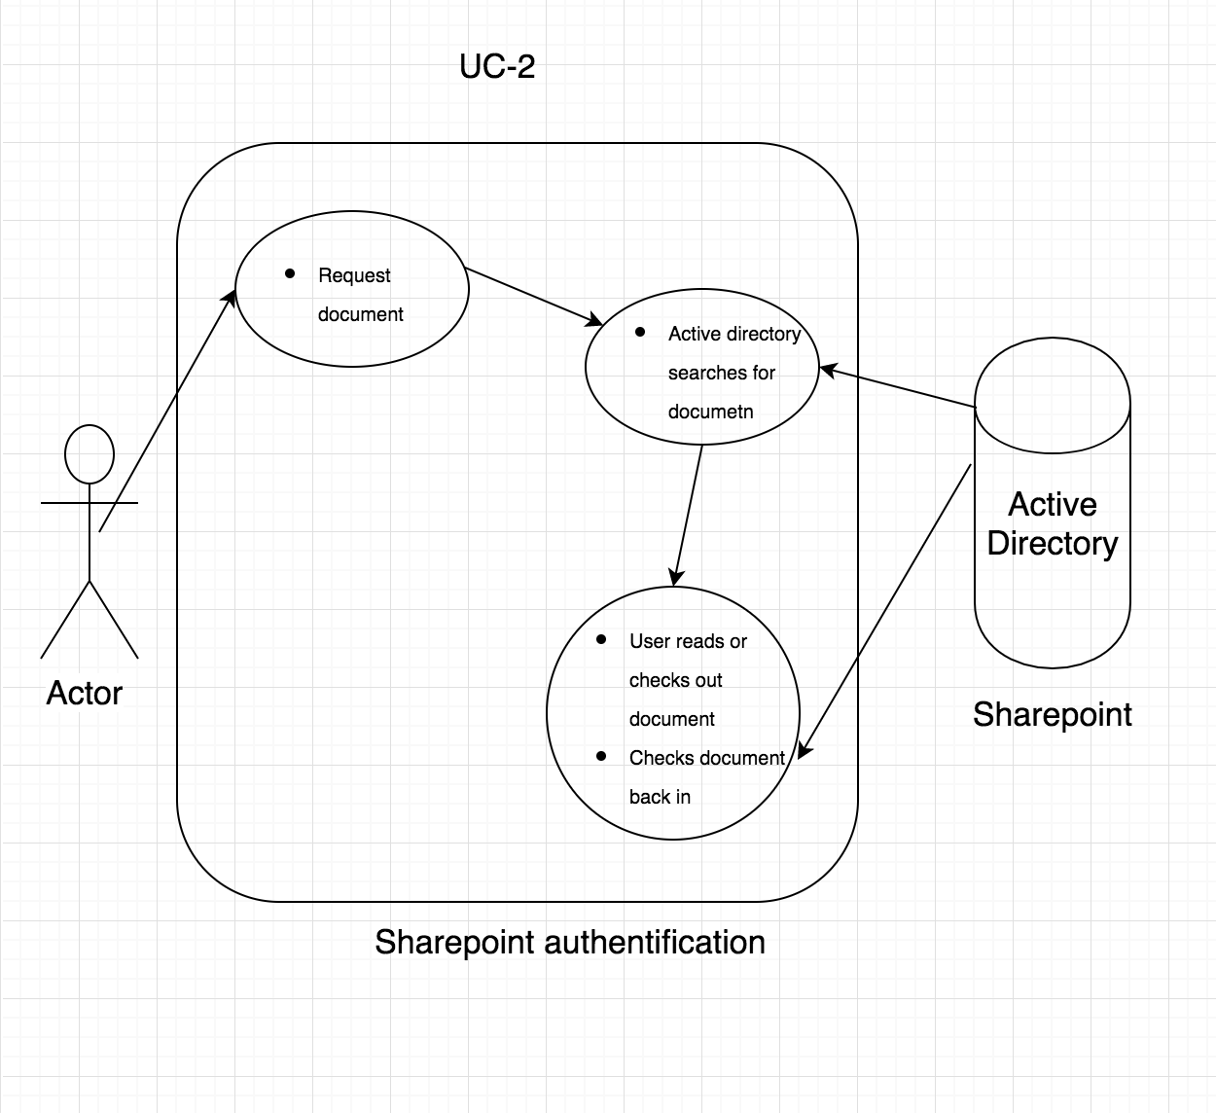
Use Case Two

Slide 25
Any Questions?

